Slide 1

CDS PRICING

Slide 2

Index
Definitions
What is a CDS
When are used
CDS spread and default probability
Formulas
From default probability to CDS spread
From CDS spread to default probability
Coding

Slide 3

A credit default swap (CDS) is a financial derivative which is used to transfer the credit risk of a reference entity from one party to another
In a standard CDS contract one party purchases credit protection from another party, to cover the loss of the face value of an asset following a credit event
CDS are expressed in basis points (one b-point is 0.01% and therefore 100 b-points are equal to 1%).

Slide 4

When Are Credit Default Swaps Used?
Speculation
Because swaps are traded, they naturally have fluctuating market values that a CDS trader can profit from. Investors buy and sell CDSs from each other, attempting to profit from the difference in prices.
Hedging
A credit default swap by itself is a form of hedging. A bank might purchase a CDS to hedge against the risk of the borrower defaulting. Insurance companies, pension funds, and other securities holders can purchase CDSs to hedge credit risk.
Arbitrage
Arbitrage generally involves purchasing a security in one market and selling it in another. CDSs can be used in arbitrage—an investor can purchase a bond in one market, then buy a CDS on the same reference entity on the CDS market.

Slide 5
Key Words: CDS Spreads and Probability of Default
CDS Spreads
It is the amount that the buyer must pay to the seller during the contract period according to a specific schedule (annual, quarterly, ...) for protection, and this amount is a percentage of the actual amount. Payments will be made until the CDS contract expires or until the credit event occurs.
Default Probability
The Probability of Default is a forward-looking Expectation Measure, which assigns a value between zero and one to the likelihood of a defined Credit Event (such as default, bankruptcy ecc..), within a specified time horizon.
If the market expects a specific asset to default, its price in the market will fall (everyone would be trying to sell the asset). Therefore, the market’s expectation of an asset’s probability of default can be obtained by analyzing the market for credit default swaps of the asset.

Slide 6
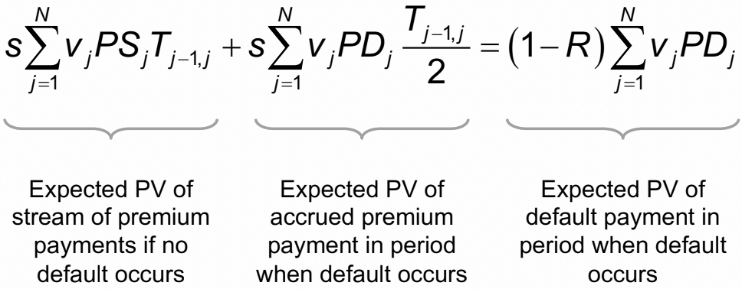

From default probability to CDS spread
Where:
s = spread
R = recovery rate
v = discount factor
PS = probability of survival
PD = probability of default

Slide 7
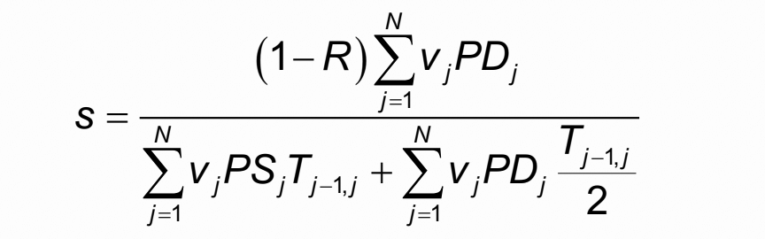
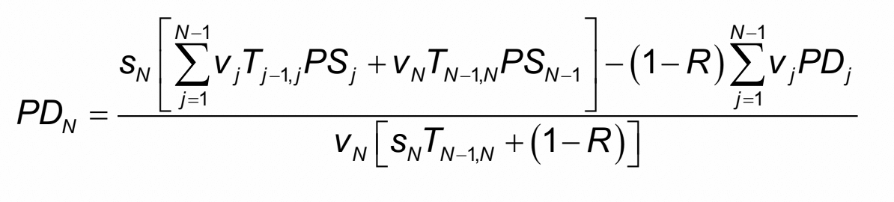
From CDS spread to default probability

Slide 8

Implementation in python

Slide 9
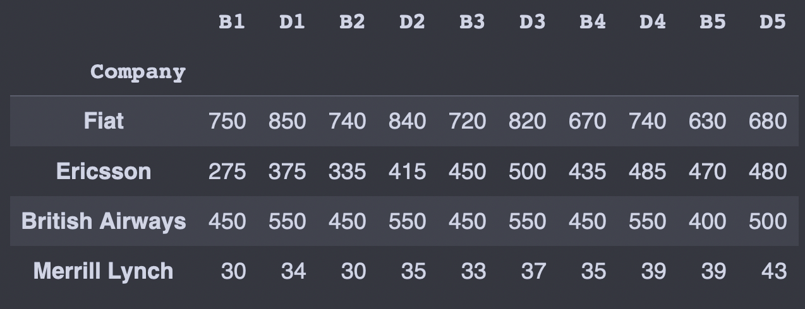
DATASET

Slide 10
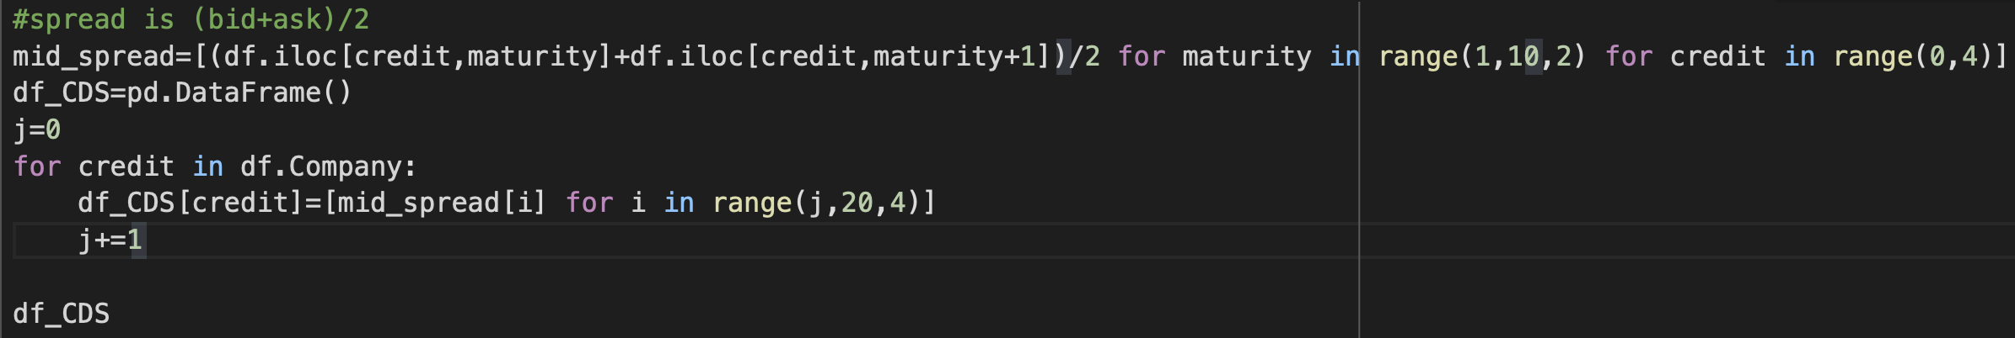
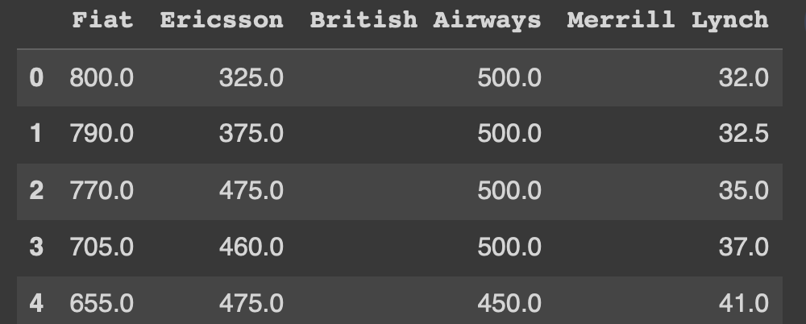
SPREAD FROM THE MARKET

Slide 11
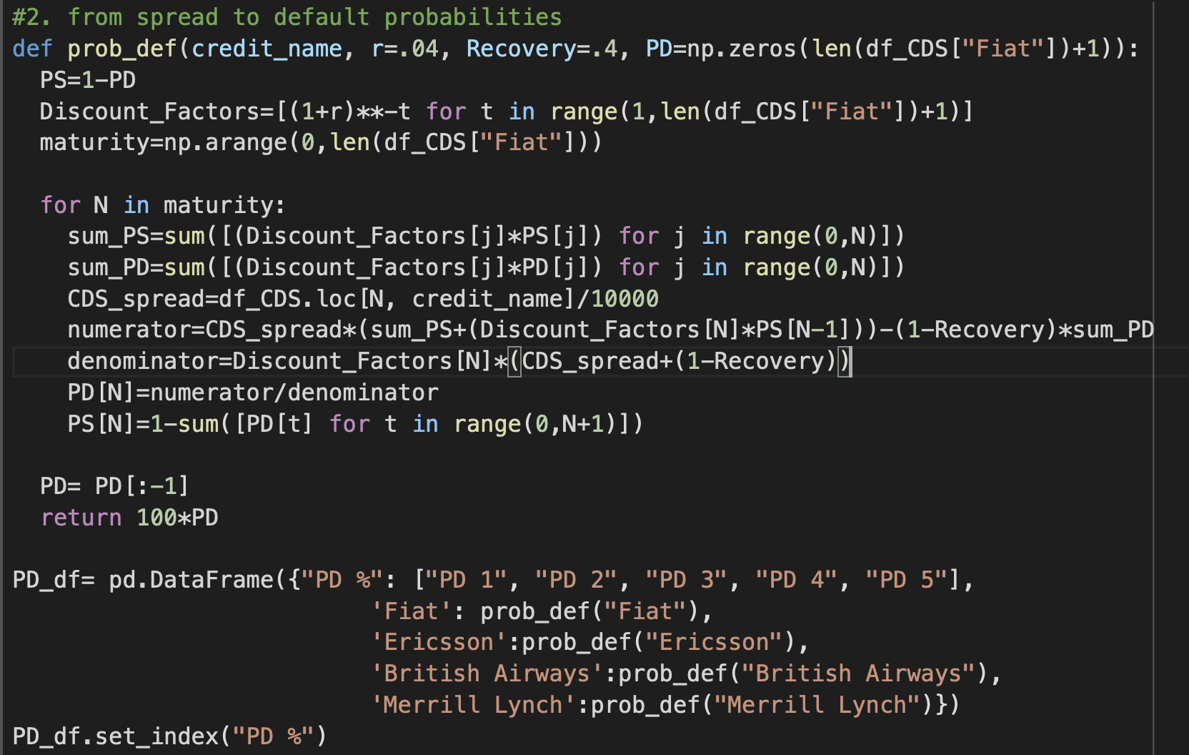
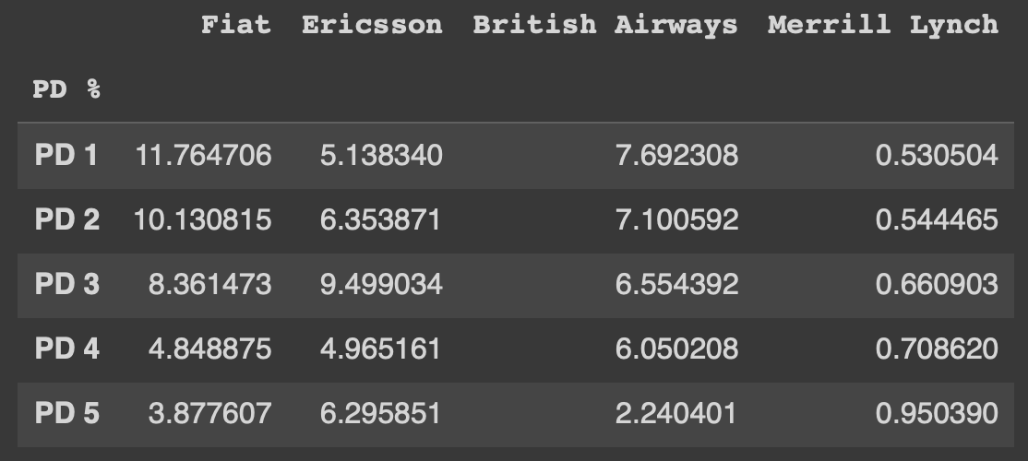
FROM SPREAD TO DEFAULT PROBABILITIES

Slide 12
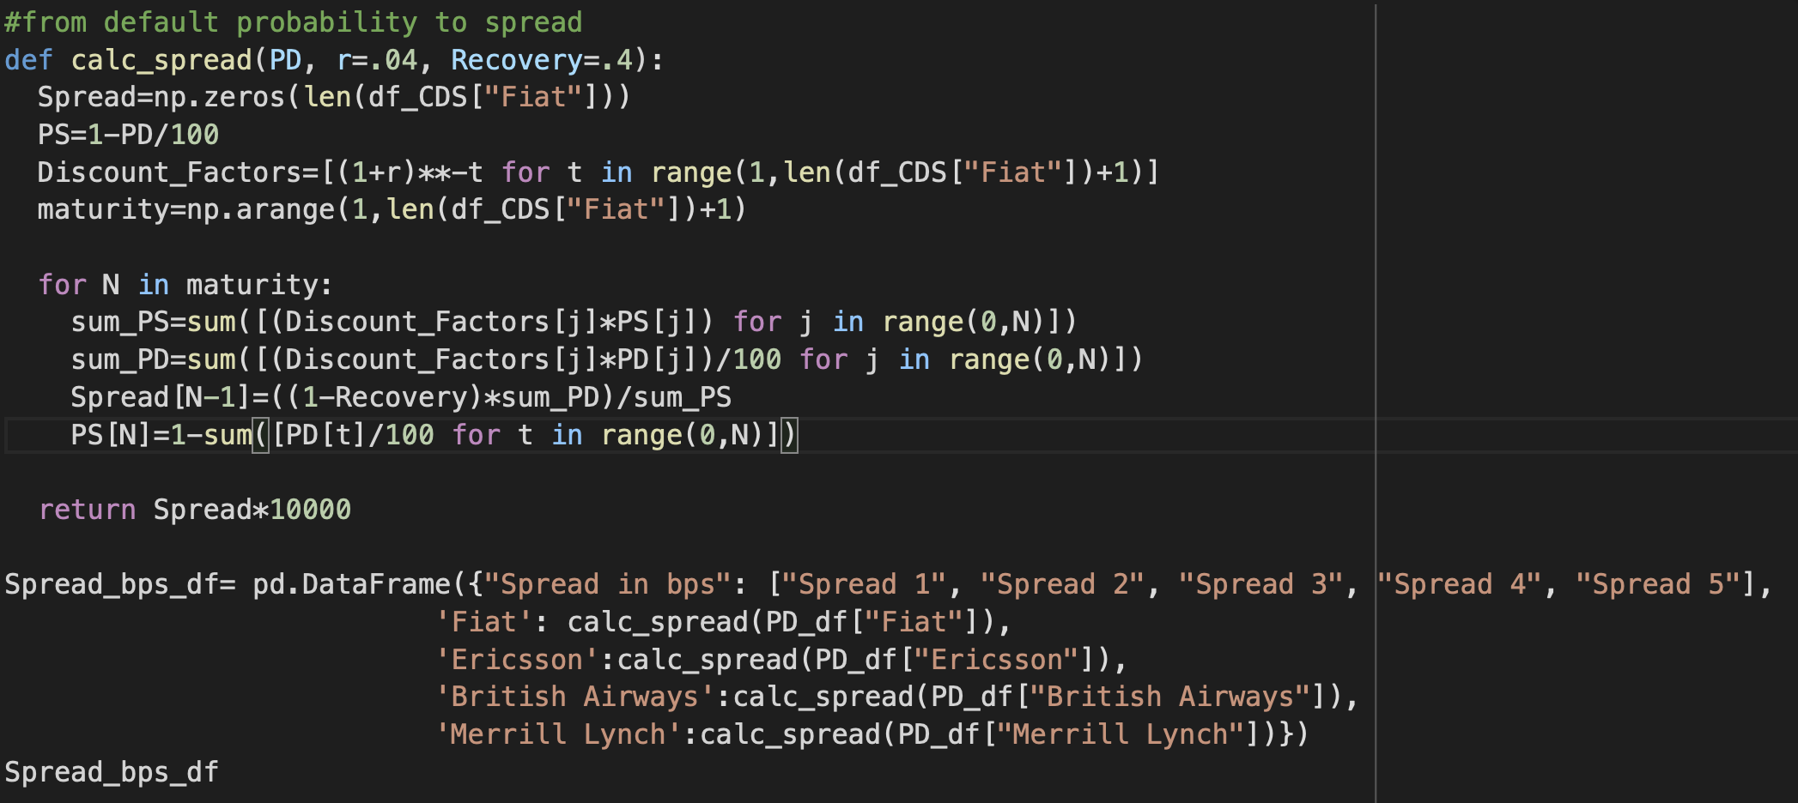
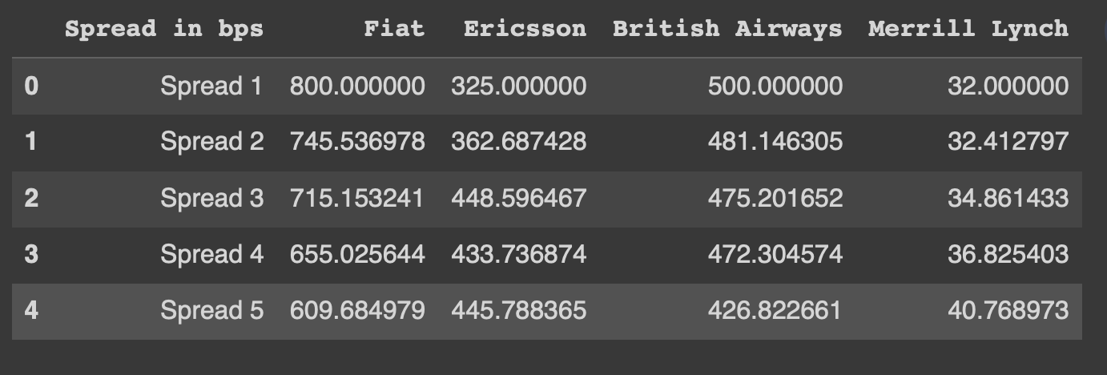
FROM DEFAULT PROBABILITIES TO SPREAD

Slide 13

THANK YOU FOR YOUR ATTENTION

